Slide 1

Java and its Evolution
Notes:
Java is related to C++, which is a direct descendent of C. Much of the character of Java is inherited from these two languages. From C, java derives its syntax. Many of java’s object-oriented features were influenced by C++. In fact, several of Java’s defining characteristics come from of are responses to its predecessors. Moreover, the creation of java was deeply rooted in the process of refinement and adaptation that has been occurring in computer programming languages for the past three decades. For these reasons, this section reviews the sequence of events and forces that led up to java. As you will see, each innovation in languages design was driven by the need to solve a fundamental problem that the preceding languages could not solve. Java is no exception.
James Gosling, Patrick Naughton, Chris Warth, Ed Frank, and Mike Sheridan conceived Java at Sun Microsystems, Inc. in 1991. It took 18 months to develop the first working version. This language was initially called “Oak” but was renamed “Java” in 1995. Between the initial implementation of Oak in the fall of 1992 and the public announcement of Java in the spring of 1995, many more people contributed to the design and evolution of the language. Bill Joy, Arthur van Hoff, Jonathan Payane, Frank Yellin, and Tim Lindholm were Key contributors to the maturing of the original prototype.
Somewhat surprisingly, the original impetus for java was not the Internet! Instead, the primary motivation was the need for a platform-independent (that is, architecture-neutral) language that could be used to create software to be embedded in various consumer electronic devices, such as microwave ovens and remote controls. As you can probably guess, many different types of CPUs are used as controllers.
The trouble with C and C++(and most other languages) is that they are designed to be compiled for a specific target. Although it is possible to compile a C++ program for just about any type of CPU, to do so requires a full C++ compiler targeted for that CPU. The problem is that compilers are expensive and time- consuming to create. An easier - and more cost – efficient – solution was needed. In an attempt of find such a solution, Gosling and others began work on a portable, platform-independent language that could be used to produce code that would run on a variety of CPUs under differing environments. This effort ultimately led to the creation of Java.
Most programmers learn early in their careers that portable programs are as elusive as they are desirable. While the quest for a way to create efficient, portable (plat form - independent) programs is nearly as old as the discipline of programming itself, it had taken a back seat to other, more pressing problems. Further, because much of the computer world had divided itself into the three competing camps of Intel, Macintosh, and Unix, most programmers stayed within their fortified boundaries, and the urgent need for portable code was reduced. However, with the advent of the Internet and the Web, the old problem of portability returned with a vengeance. After all, the Internet consists of a diverse, distributed universe populated with many types of computers, operating systems, and CPUs. Even though many types of platforms are attached to the Internet, users would like them all to be able to run the same program. What was once an irritation but low-priority had become a high-profile necessity.
As mentioned earlier, Java derives much of its character from C and C++. This is by intent. The java designer knew that using the familiar syntax of C and echoing the object-oriented features of C++ would make their language appealing to the legions of experienced C/C++ programmers. In addition to the surface similarities, Java shares some of the other attributes that helped make C and C++ Successful. First, Java was designed, tested, and refined by real, working programmers. It is a language grounded in the needs and experiences of the people who devised it. Thus, Java is also a programmer’s language. Second. Java is cohesive and logically consistent. Third, except for those constraints imposed by the Internet environment, java gives you, the programmer, full control. If you program well, your programs reflect it. If you program poorly, your programs reflect that, too. Put differently, java is not a language with training wheels. It is a language for professional programmers.
As mentioned at the start of this article, computer languages evolve for two reasons: to adapt to changes in environment and to implement advances in the art of programming. The environmental change that prompted java was the need for platform-independent programs destined for distribution on the Internet. However, java also embodies changes in the way that people approach the writing of programs. Thus, java is not a language that exists in isolation. Rather, it is the current instance of an ongoing process begun many years ago. This fact alone is enough to ensure java a place in computer language history. Java is to Internet programming what C was to systems programming: a revolutionary force that will change the world.

Slide 2
Contents
Java Introduction
Java Features
How Java Differs from other OO languages
Java and the World Wide Web
Java Environment
Build your first Java Program
Summary and Reference

Slide 3
Java - An Introduction
Java - The new programming language developed by Sun Microsystems in 1991.
Originally called Oak by James Gosling, one of the inventors of the Java Language.
Java -The name that survived a patent search
Java Authors: James , Arthur Van , and others
Java is really “C++ -- ++ “

Slide 4
Java Introduction
Originally created for consumer electronics (TV, VCR, Freeze, Washing Machine, Mobile Phone).
Java - CPU Independent language
Internet and Web was just emerging, so Sun turned it into a language of Internet Programming.
It allows you to publish a webpage with Java code in it.

Slide 5
Java Milestones
Year | Development
1990 | Sun decided to developed special software that could be used for electronic devices. A project called Green Project created and head by James Gosling.
1991 | Explored possibility of using C++, with some updates announced a new language named “Oak”
1992 | The team demonstrated the application of their new language to control a list of home appliances using a hand held device.
1993 | The World Wide Web appeared on the Internet and transformed the text-based interface to a graphical rich environment. The team developed Web applets (time programs) that could run on all types of computers connected to the Internet.

Slide 6
Java Milestones
Year | Development
1994 | The team developed a new Web browsed called “Hot Java” to locate and run Applets. HotJava gained instance success.
1995 | Oak was renamed to Java, as it did not survive “legal” registration. Many companies such as Netscape and Microsoft announced their support for Java
1996 | Java established itself it self as both 1. “the language for Internet programming” 2. a general purpose OO language.
1997- | A class libraries, Community effort and standardization, Enterprise Java, Clustering, etc..

Slide 7
Sun white paper defines Java as:
Simple and Powerful
Safe
Object Oriented
Robust
Architecture Neutral and Portable
Interpreted and High Performance
Threaded
Dynamic

Slide 8
Java Attributes
Familiar, Simple, Small
Compiled and Interpreted
Platform-Independent and Portable
Object-Oriented
Robust and Secure
Distributed
Multithreaded and Interactive
High Performance
Dynamic and Extensible

Slide 9
Java is Compiled and Interpreted
Programmer
Hardware and
Operating System
Source Code
Byte Code
Text Editor
Compiler
Interpreter
.java file
.class file
Notepad, emacs,vi
javac
java
appletviewer
netscape

Slide 10
Compiled Languages
Programmer
Source Code
Object Code
Executable Code
Text Editor
Compiler
linker
.c file
.o file
a.out file
Notepad, emacs,vi
gcc

Slide 11
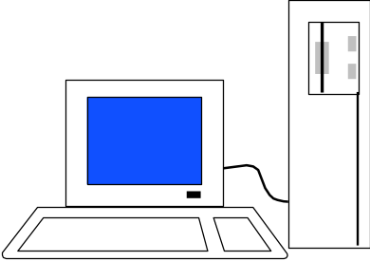
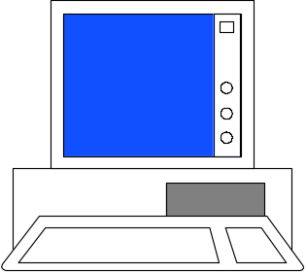
Total Platform Independence
JAVA COMPILER
(translator)
JAVA BYTE CODE
(same for all platforms)
JAVA INTERPRETER
(one for each different system)
Windows 95
Macintosh
Solaris
Windows NT

Slide 12
Architecture Neutral & Portable
Java Compiler - Java source code (file with extension .java) to bytecode (file with extension .class)
Bytecode - an intermediate form, closer to machine representation
A interpreter (virtual machine) on any target platform interprets the bytecode.

Slide 13
Architecture Neutral & Portable
Porting the java system to any new platform involves writing an interpreter.
The interpreter will figure out what the equivalent machine dependent code to run

Slide 14

Rich Class Environment
Core Classes
  language
  Utilities
  Input/Output
  Low-Level Networking
  Abstract Graphical User Interface
Internet Classes
  TCP/IP Networking
  WWW and HTML
  Distributed Programs

Slide 15
How Does Java Compares to C++ and Other OO Languages

Slide 16
Overlap of C, C++, and Java
C++
C
Java

Slide 17
Java better than C++ ?
No Typedefs, Defines, or Preprocessor
No Global Variables
No Goto statements
No Pointers
No Unsafe Structures
No Multiple Inheritance
No Operator Overloading
No Automatic Coercions
No Fragile Data Types
?

Slide 18
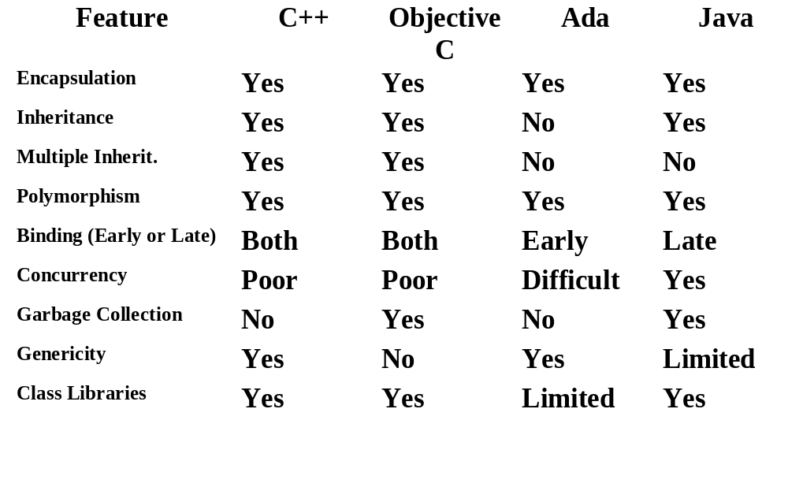
Object Oriented Languages -A Comparison

Slide 19
Java Integrates
Power of Compiled Languages
and
Flexibility of Interpreted Languages

Slide 20
Java Applications
We can develop two types of Java programs:
  Stand-alone applications
  Web applications (applets)

Slide 21
Applications v/s Applets
Different ways to run a Java executable are:
  Application- A stand-alone program that can be invoked from command line . A program that has a “main” method
  Applet- A program embedded in a web page , to be run when the page is browsed . A program that contains no “main” method

Slide 22
Applets v/s Applications
Different ways to run a Java executable are
  Application- A stand-alone program that can be invoked from command line . A program that has a “main” method
  Applet- A program embedded in a web page , to be run when the page is browsed . A program that contains no “main” method
Application –Executed by the Java interpreter.
Applet- Java enabled web browser.

Slide 23
Java and World Wide Web
Turning the Web into an Interactive and Application Delivery Platform

Slide 24
What is World Wide Web ?
Web is an open-ended information retrieval system designed to be used in the Internet wide distributed system.
It contains Web pages (created using HTML) that provide both information and controls.
Unlike a menu driven system--where we are guided through a particular direction using a decision tree, the web system is open ended and we can navigate to a new document in any direction.

Slide 25
Web Structure of Information Search/Navigation

Slide 26
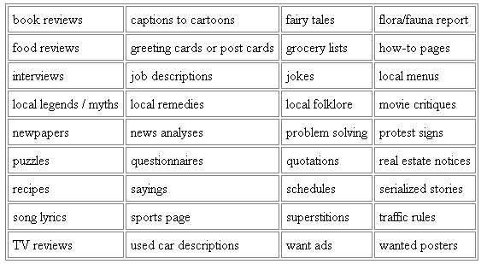
Web as a delivery Vehicle

Slide 27


Execution of Applets
1
2
3
4
5
APPLET Development “hello.java”
AT
SUN.COM
hello.class
AT SUN’S
WEB SERVER
Create Applet
tag in HTML
document
Accessing
from
Unimelb.edu.au
The browser creates
a new window and
a new thread and
then runs the code
Hello Java
<app=
“Hello”>
The Internet
Hello

Slide 28
Significance of downloading Applets
Interactive WWW
Flashy animation instead of static web pages
Applets react to users input and dynamically change
Display of dynamic data
WWW with Java - more than a document publishing medium
http://www.javasoft.com/applets/alpha/applets/StockDemo/standalone.html

Slide 29
Power of Java and the Web
Deliver applications, not just information
Eliminate porting
Eliminate end-user installation
Slash software distribution costs
Reach millions of customers - instantly

Slide 30

Java Development Kit
javac - The Java Compiler
java - The Java Interpreter
jdb- The Java Debugger
appletviewer -Tool to run the applets
javap - to print the Java bytecodes
javaprof - Java profiler
javadoc - documentation generator
javah - creates C header files

Slide 31
Java Environment

Slide 32
Java Development Kit
javac - The Java Compiler
java - The Java Interpreter
jdb- The Java Debugger
appletviewer -Tool to run the applets
javap - to print the Java bytecodes
javaprof - Java profiler
javadoc - documentation generator
javah - creates C header files

Slide 33
Process of Building and Running Java Programs
Text Editor
Java Source
Code
javadoc
HTML Files
javac
Java Class File
javah
Header Files
java
jdb
Outout

Slide 34
Let us Try Out
Building your first Java Program

Slide 35
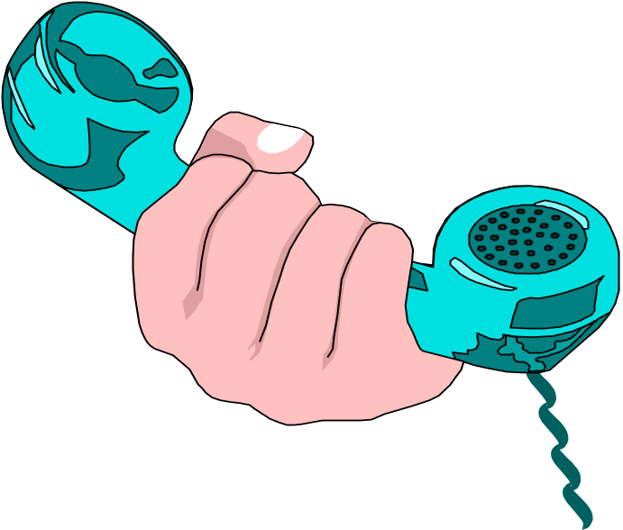
Hello Internet
// hello.java: Hello Internet program
class HelloInternet
{
public static void main(String args[])
{
System.out.println(“Hello Internet”);
}
}

Slide 36
Program Processing
Compilation
  # javac hello.java
  results in HelloInternet.class
Execution
  # java HelloInternet
  Hello Internet
  #

Slide 37
Simple Java Applet
//HelloWorld.java
import java.applet.Applet;
import java.awt.*;
public class HelloWorld extends Applet {
  public void paint(Graphics g) {
  g.drawString (“Hello World !”,25, 25);
  }
}

Slide 38
Calling an Applet
<HTML>
<TITLE>HELLO WORLD APPLET</TITLE>
<HEAD>THE HELLO WORLD APPLET</HEAD>
<APPLET CODE=“HelloWorld.class” width=500 height=500>
</APPLET>
</HTML>

Slide 39
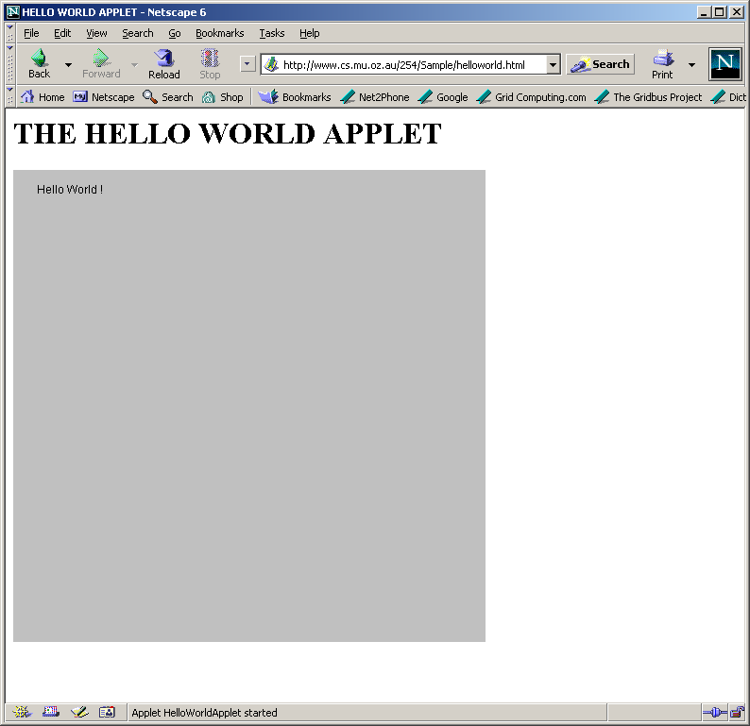
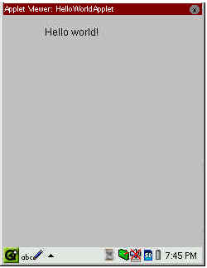
Applet Execution
Using AppletViewer
Using Browser

Slide 40
Java on my platform ?
Sun (SPARC) ftp://java.sun.com
Sun(x86) ftp://xm.com:/pub/
IBM(Aix, OS/2)ftp://ncc.hursley.ibm.com/javainfo
DEC(Alpha OSF/1) http://www.gr.osf.org:8001/projects/web/java/
SGI http://liawww.epfl.ch/~simon/java/irix-jdk.html
HP http://www.gr.osf.org:8001/projects/web/java
linux http://www.blackdown.org
AT & T http://www.gr.osf.org:8001/projects/web/java
Windows 3.1 http://www.alphaworks.ibm.com

Slide 41
Summary
Java has emerged as a general purpose OO language.
It supports both stand alone and Internet Applications.
Makes the Web Interactive and medium for application delivery.
Provides an excellent set of Tools for Application Development.
Java is ubiquitous!

Slide 42
References
Chapter 2: “Java Evolution”, Programming with Java by Balagurusamy, TMH, New Delhi, India
Optional:
  Chapter 1: “Mastering C++” by V. Rajuk and R. Buyya, Tata McGraw Hill, New Delhi, India.

